Slide 1
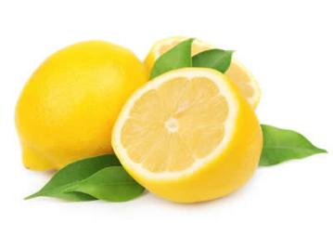
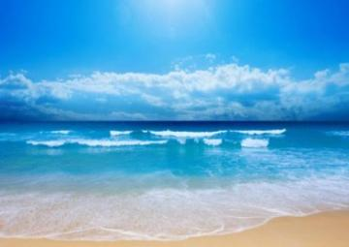
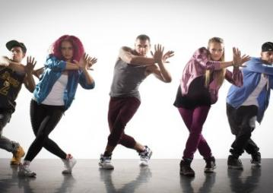
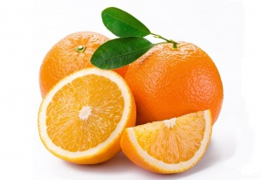
Use the first letters of the names of the things you see in the pictures and you will know what city we are going to travel
1
2
3
N
L
eck
emon
O
cean
4
5
6
D
O
N
ance
range
ight

Slide 2
Agree or disagree
-Trafalgar Square is in Moscow.
-London is the capital of the UK.
-London is not an old city
- There are a lot of places of interest in London.
- London is a beautiful city.
London stands on the Amur River
In Backer street we can visit the museum of the most famous detective.

Slide 3
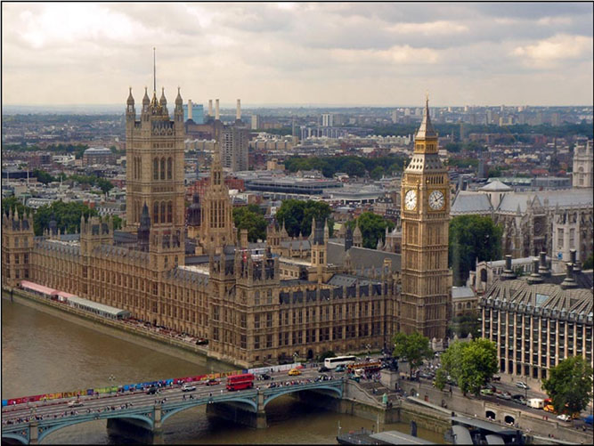
London and its Sights

Slide 4
Read and match
Big
Trafalgar
Bloody
White
Buckingham
Westminster
The Houses of
The Tower of
The British
Palace
Tower
Museum
London
Abbey
Ben
Square
Tower
Parliament

Slide 5
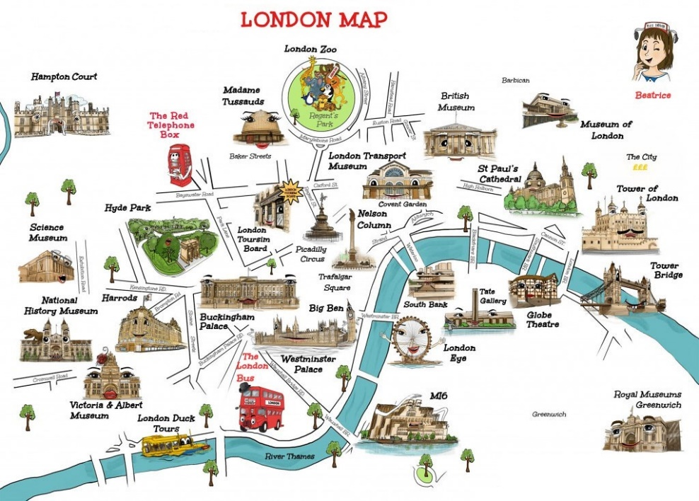
Мой Лондон умещается в руке –
в чердачного кота улыбке странной,
В жемчужинах случайного тумана,
в английской розы белом лепестке.
Танцует круговую джигу чай
в заварочной стеклянной бальной зале,
Отточенные кисточки мгновений
раскрашивают контурные сны –
Я наконец-то научилась Лондон
опознавать, как место «там, где ты».

Slide 6
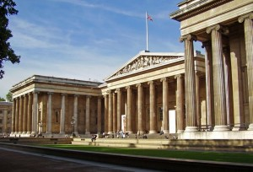
Bus Stop No.1
Museums

Slide 7
Museums
A. It is an art museum which has more than 2,300 paintings
1)Imperial War Museum
B. In this museum you can see the wax models of great characters in history and art
2) National
Gallery
C. It is famous for its exhibition of dinosaur skeletons. It has five main collections: botany, entomology, mineralogy, paleontology and zoology
3) Natural History Museum
D. It has a big collection of military machines such as tanks and aeroplanes and many original uniforms of soldiers
4) London Transport Museum
5) Madam Tussaud’s Museum
E. From uniforms, posters and tickets to
horse buses, electric trams and trolley buses – all these things you can find in this museum

Slide 8
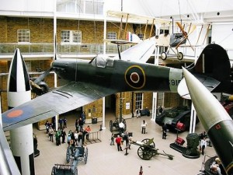
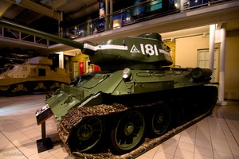
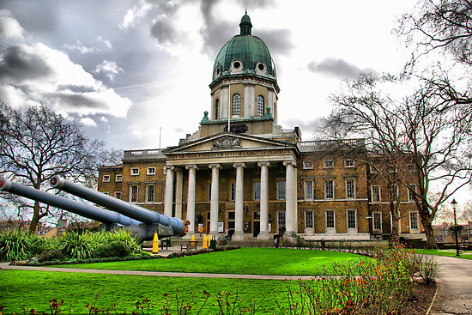
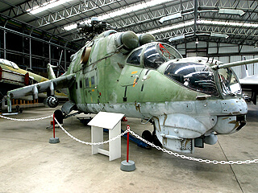
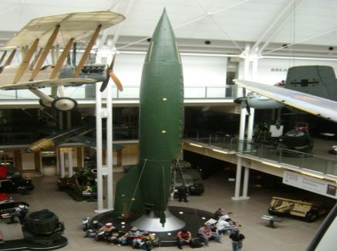
Imperial War Museum

Slide 9
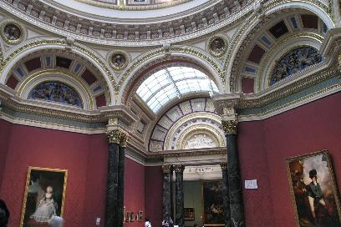
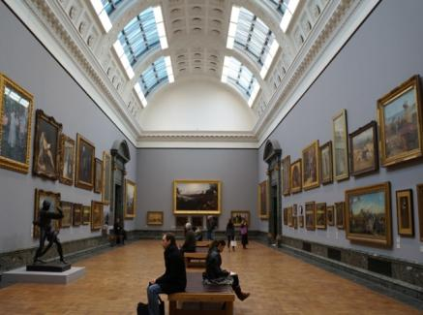
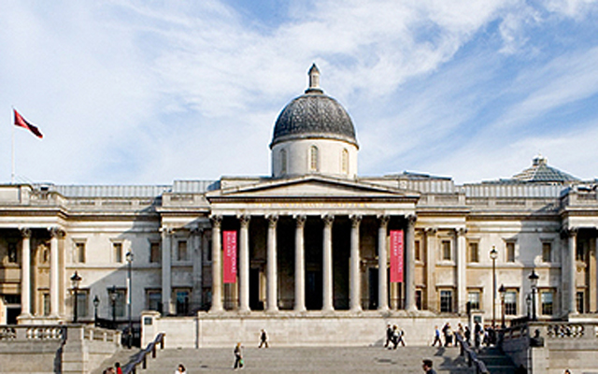
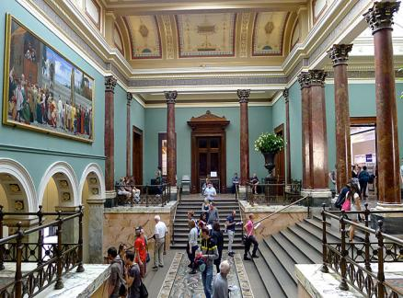
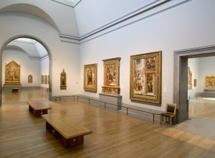
National Gallery

Slide 10
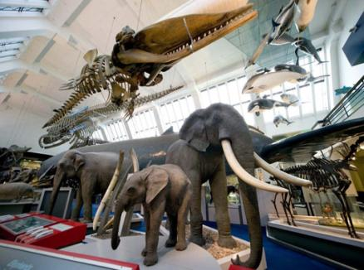
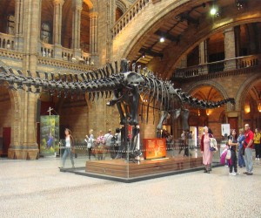
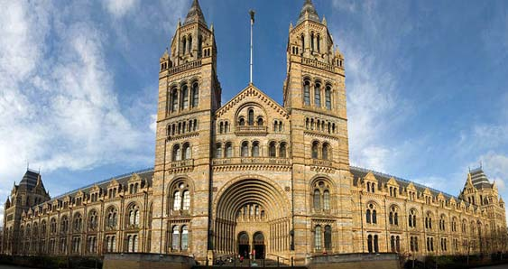
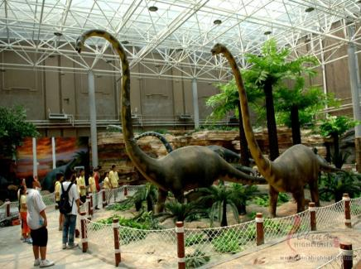
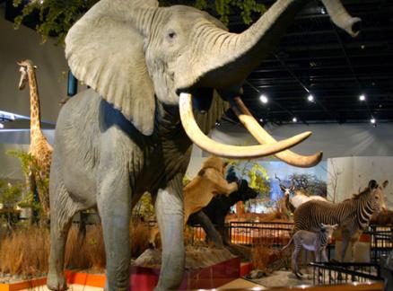
Natural History Museum

Slide 11
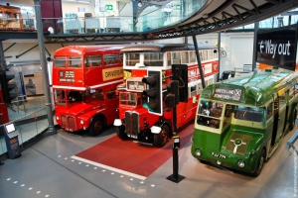
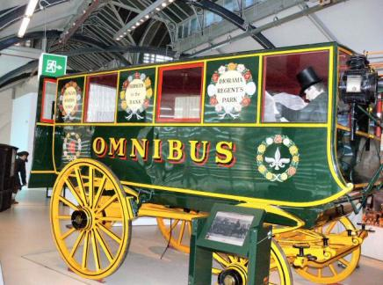
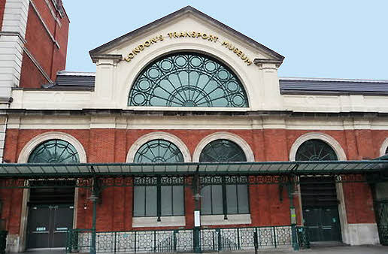
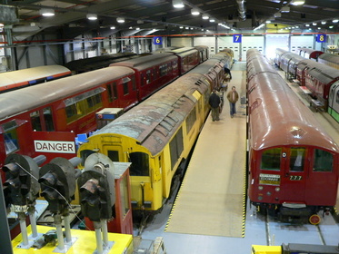
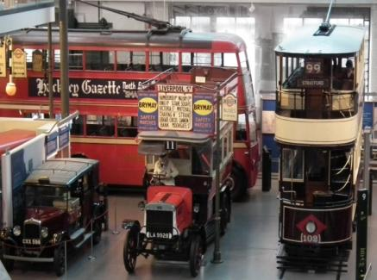
London Transport Museum

Slide 12
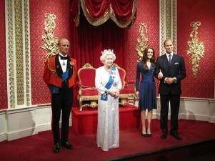
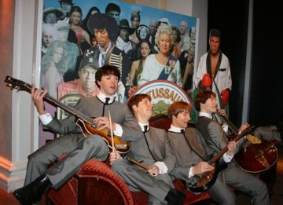
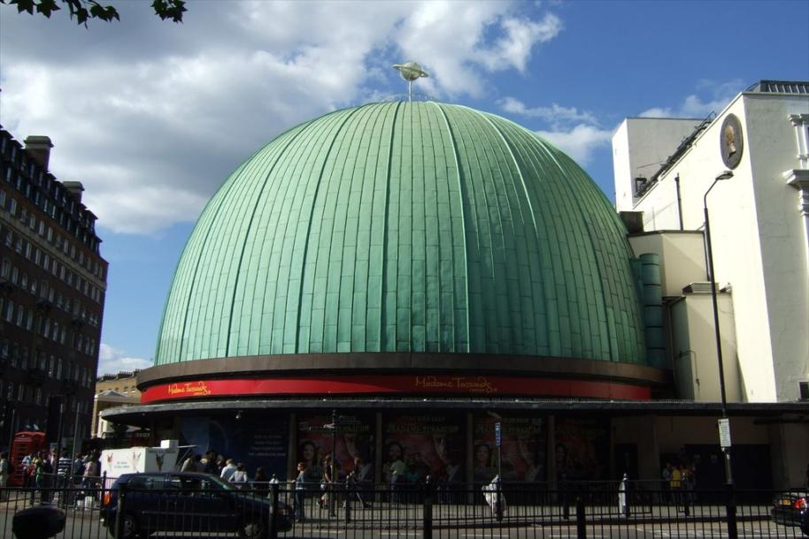
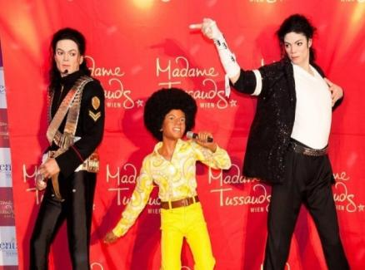
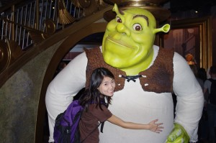
Madam Tussaud’s Museum

Slide 13
Up, down, up, down,
(Поднимаем руки вверх и вниз)
Which is the way
(Разводим руки в стороны)
To London town?
Where? Where?
(Поворачиваемся в стороны)
Up in the air,
(Смотрим вверх)
Close your eyes –
(Закрываем глаза)
And you are there!
(Открываем глаза)

Slide 14
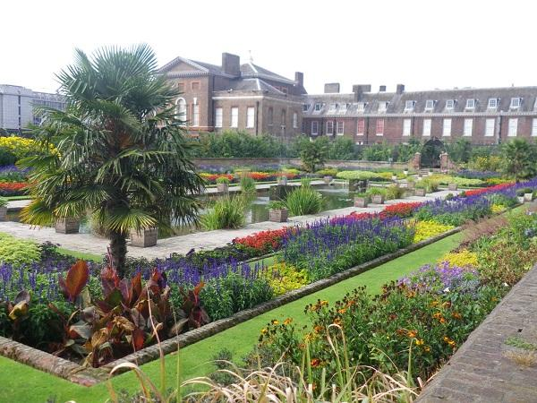
Bus Stop No.2
Parks

Slide 15
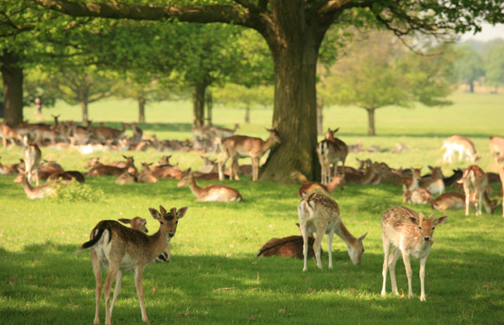
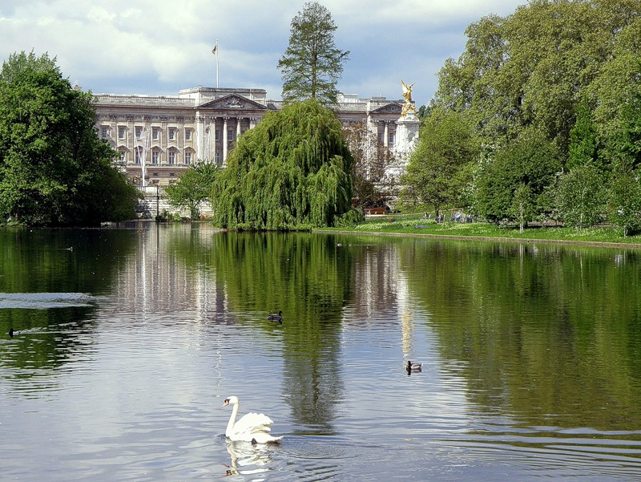
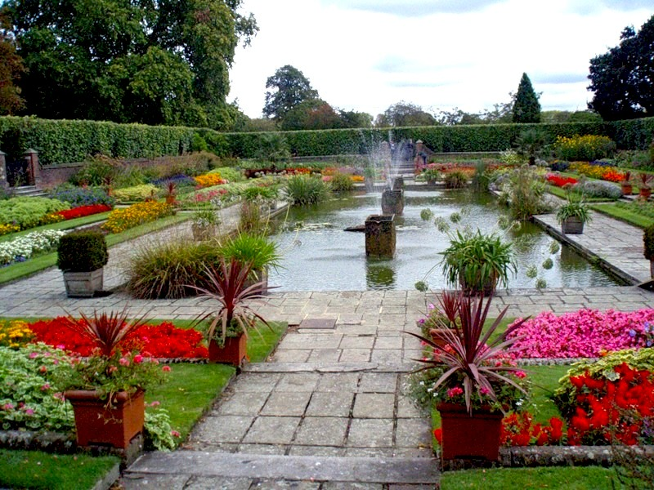
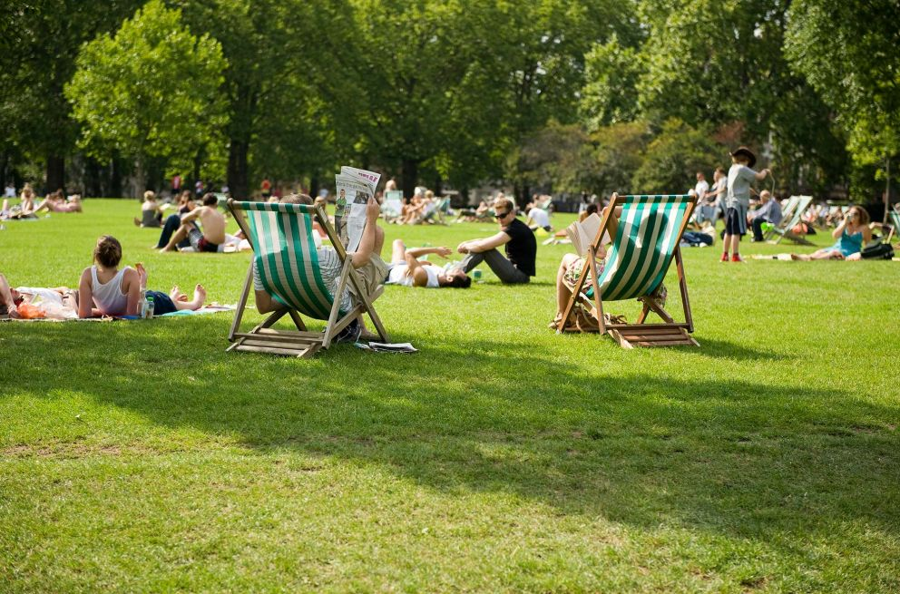
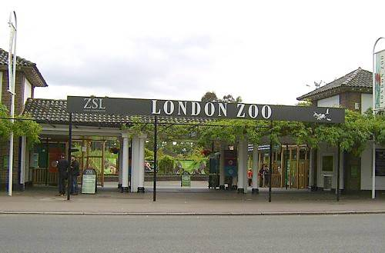
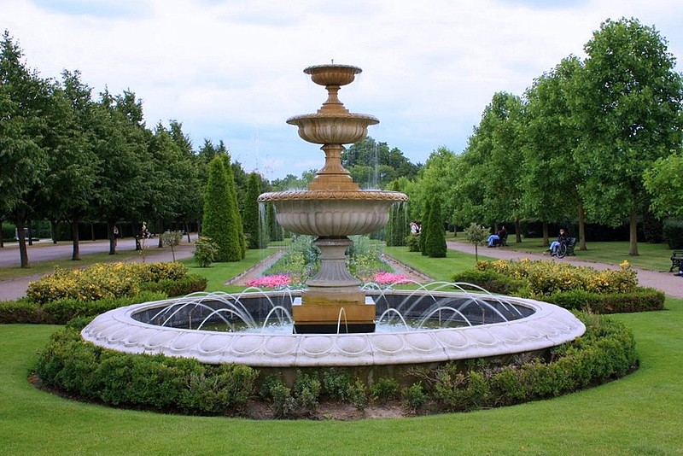
Hyde Park
Richmond Park
St James’s Park
Kensington Gardens
Regent’s Park
Green Park

Slide 16
Let’s find next place on your map: It is opposite to Big Ben and next to the Tate Gallery

Slide 17
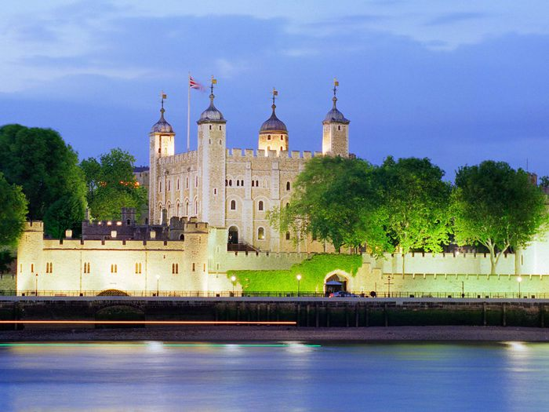
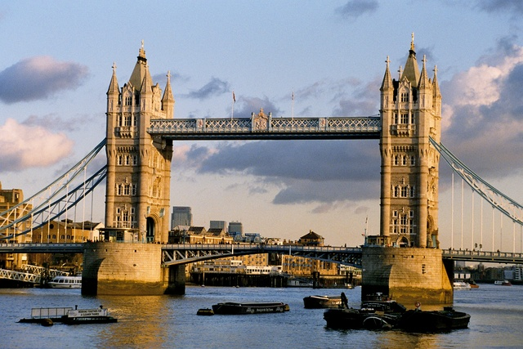
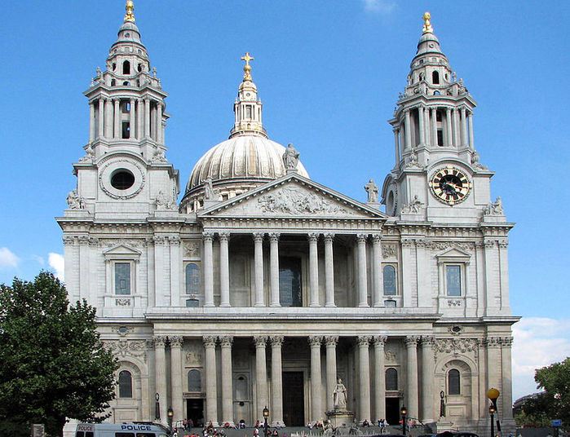
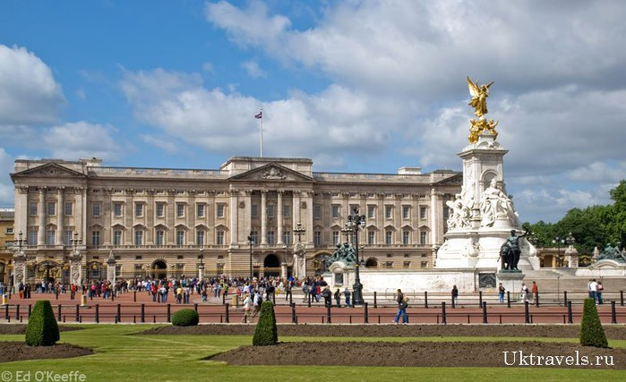
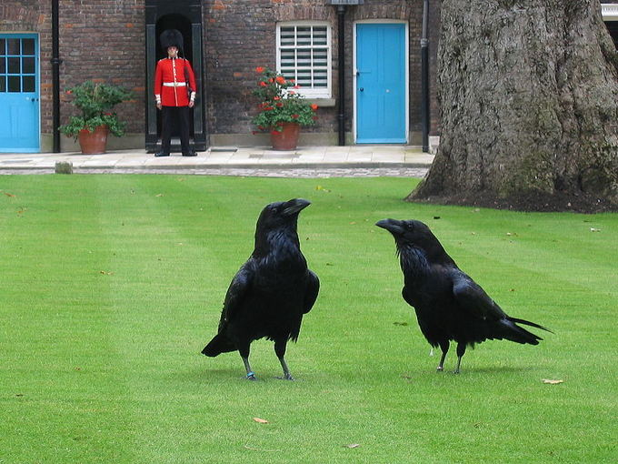
What sights of London would you like to visit? Why?
I would like to visit…because …

Slide 19
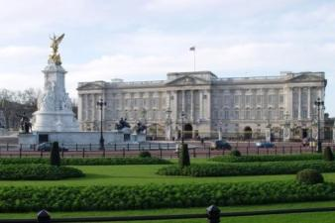
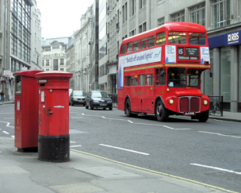
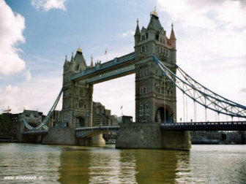
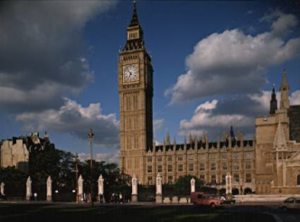
Thank you!!!

